Slide 1
Introduction to Database Security
CIS 483 – Database Security
Computer Information Systems
University of Louisville
Ghiyoung Im, PhD
* Source: Database Security & Auditing: Protecting Data Integrity & Accessibility, Ch1

Slide 2
Start Tegrity!

Slide 3
Objectives
Define security
Describe an information system and its components
Define database management system functionalities
Outline the concept of information security
Identify the major components of information security architecture
Define database security
List types of information assets and their values
Describe security methods

Slide 4
Why Database Security ? (1)
Databases are the crown jewel of the organization
There is a tendency to audit public-facing systems such as web servers and firewalls
Too much reliance on the DBA
New breed of attacks, which bypass firewalls – SQL injection!

Slide 5
Why Database Security ? (2)
Database has sensitive data
IT infrastructures have been re-architected to provide access for everyone with a web-browser to applications running on corporate networks
Authorized access is expanding to a wider range of users: employees, customers, contractors, suppliers, partners and third-party vendors
Mobile apps, hand-held browsers, Wi-Fi, Internet-facing Web apps and a flood of VPN connections are rendering perimeter and “super secure” network strategies inadequate
A defensive strategy security is developed in layers. Network perimeters, operating systems, applications and databases are now autonomous layers requiring separate and distinct policies of protection
* Source: John Ottman

Slide 6
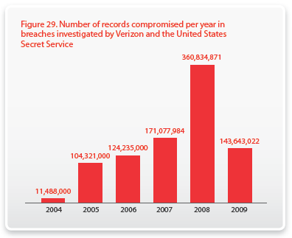
Verizon 2010 Data Breach Report (1)
* 2008 breaches: http://www.idtheftcenter.org/artman2/publish/lib_survey/ITRC_2008_Breach_List.shtml

Slide 7
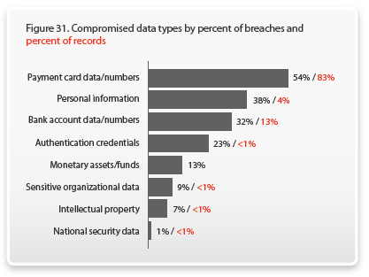
Verizon 2010 Data Breach Report (2)

Slide 8
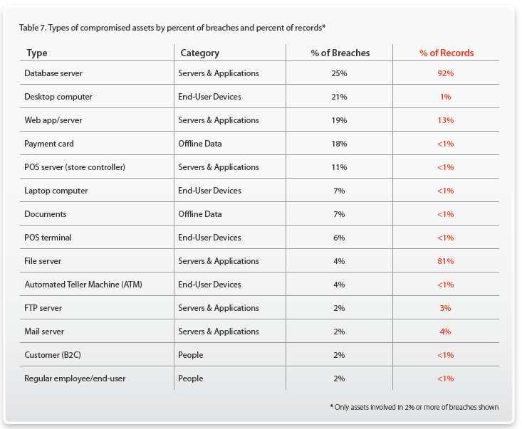
Verizon 2010 Data Breach Report (3)

Slide 9
Database Security Analyst (DSA)
A new role is emerging within IT
DBA: Maintain and optimize various enterprise databases
Security professionals: Not experts in database security technologies
Auditors and regulatory compliances: Pressuring enterprises to focus more on role separation and to monitor privileged users
Database security analyst
This role not existing in most organizations
* Source: Forrester

Slide 10
Database Security
Database security: degree to which data is fully protected from tampering or unauthorized acts
Comprises information system and information security concepts
Information system: comprised of components working together to produce and generate accurate information
Categorized based on usage

Slide 11
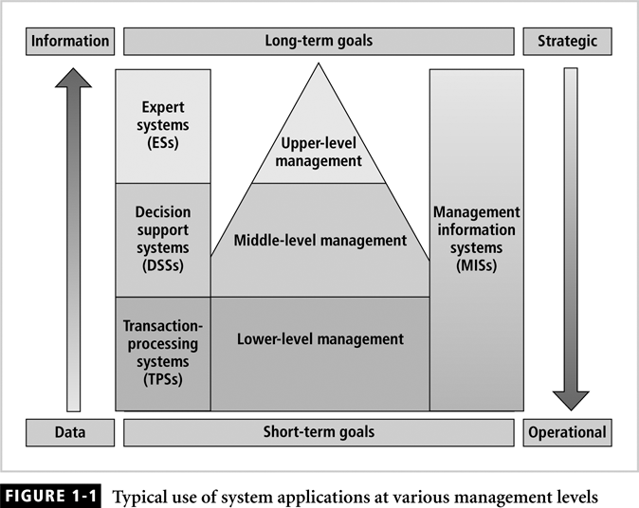
Information Systems (1)

Slide 12
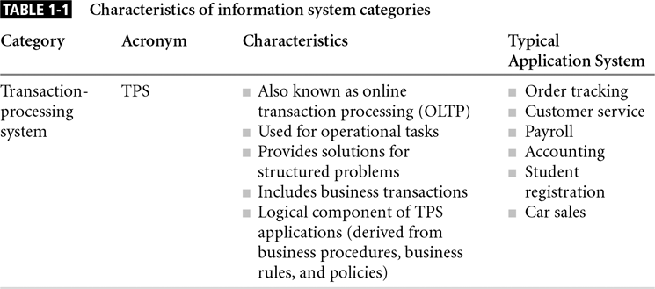
Information Systems (2)

Slide 13
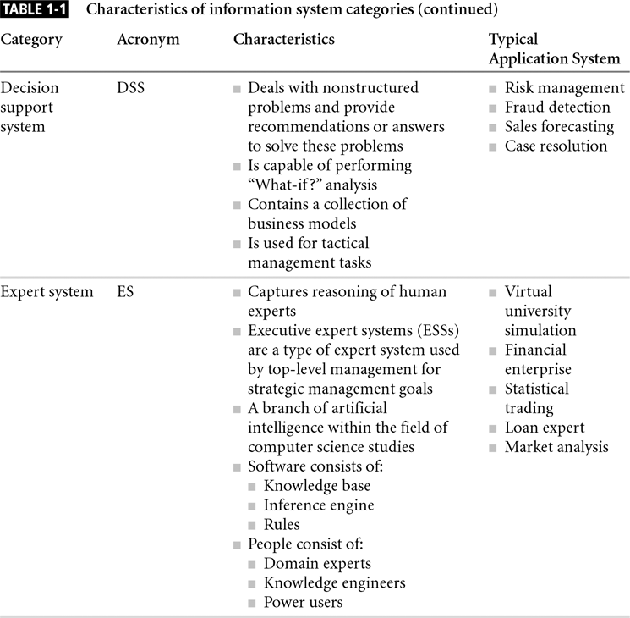
Information Systems (3)

Slide 14

Example: iPhone 4S
What kind of data are involved in each IS?
What decisions are supported?
How attractive are the data to attackers?
 | Data Involved | Decision Supported
ESS
DSS
TPS

Slide 15
Information Systems (4)
Client/server architecture:
Based on the business model
Can be implemented as one-tier; two-tier; n-tier
Composed of three layers
Tier: physical or logical platform
Three tiers: presentation, application, data layer
Database management system (DBMS): collection of programs that manage database

Slide 16
Database Management
Essential to success of information system
DBMS functionalities:
Organize data
Store and retrieve data efficiently
Manipulate data (update and delete)
Enforce referential integrity and consistency
Enforce and implement data security policies and procedures
Back up, recover, and restore data

Slide 17
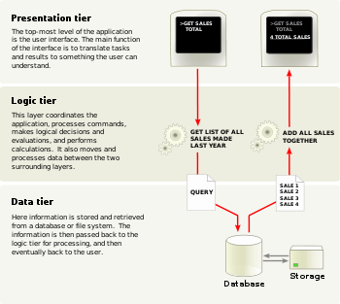
Information Systems (5)
* http://en.wikipedia.org

Slide 18
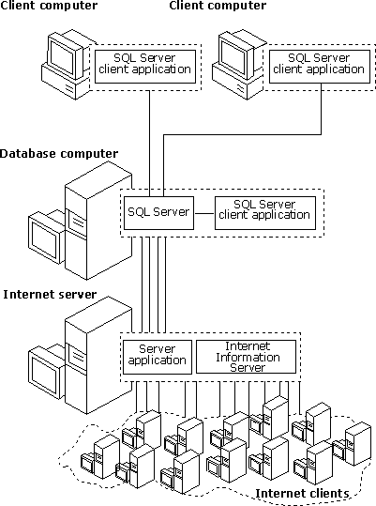
Information Systems (6)
* http://technet.microsoft.com/en-us/library/cc917543.aspx

Slide 19
Basic Steps to Data Access
You are using an inventory management system at company A, and want to review an inventory level of a product B. Describe the necessary steps that your application must go through for access to the desired data.

Slide 20
Database Security Coverage
Database Security

Slide 21
Information Security (1)
Information is one of an organization’s most valuable assets
Information security: consists of procedures and measures taken to protect information systems components
C.I.A. triangle: confidentiality, integrity, availability
Security policies must be balanced according to the C.I.A. triangle

Slide 22
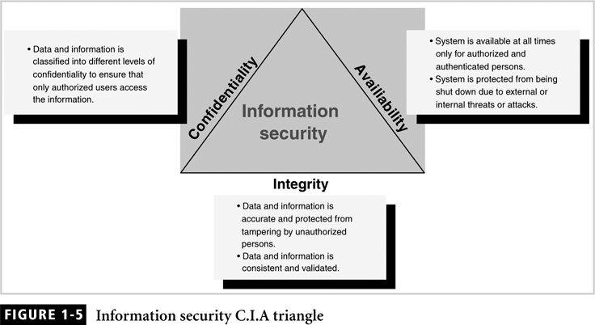
Information Security (2)

Slide 23
Confidentiality
Addresses two aspects of security:
Prevention of unauthorized access
Information disclosure based on classification
Classify company information into levels:
Each level has its own security measures
Usually based on degree of confidentiality necessary to protect information

Slide 24
Integrity (1)
Consistent and valid data, processed correctly, yields accurate information
Information has integrity if:
It is accurate
It has not been tampered with
Read consistency: each user sees only his changes and those committed by other users

Slide 25
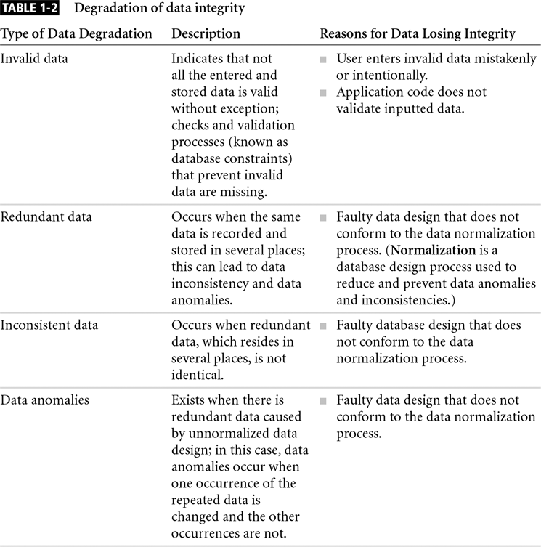
Integrity (2)

Slide 26
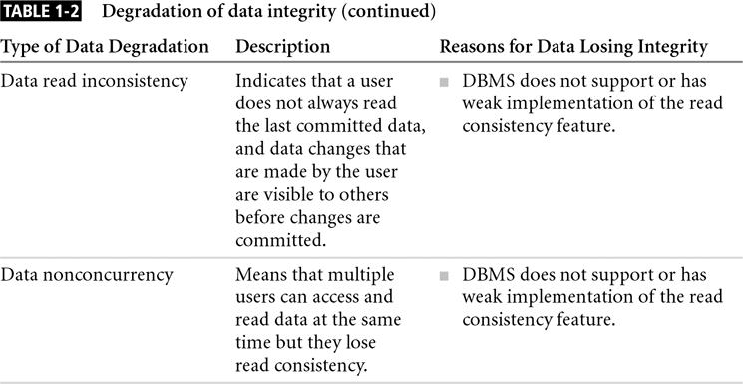
Integrity (3)

Slide 27
Availability
Systems must be always available to authorized users
Systems determines what a user can do with the information
Reasons for a system to become unavailable:
External attacks and lack of system protection
System failure with no disaster recovery strategy
Overly stringent and obscure security policies
Bad implementation of authentication processes

Slide 28
Information Security Architecture (1)
Protects data and information produced from the data
Model for protecting logical and physical assets
Is the overall design of a company’s implementation of C.I.A. triangle

Slide 29
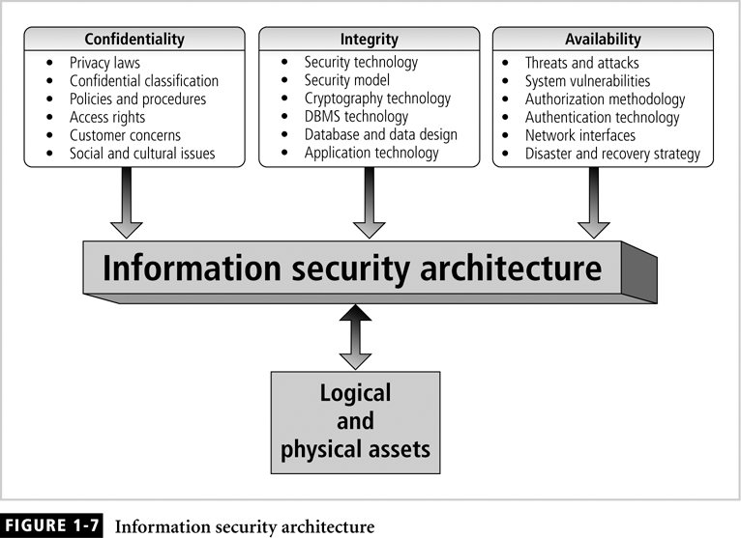
Information Security Architecture (2)

Slide 30
Keep C.I.A. Always?
Which organizations have priorities in confidentiality, integrity, and availability, respectively?
Do we need to keep C.I.A. all the time?

Slide 31
Information Security Architecture (3)
Components include:
Policies and procedures
Security personnel and administrators
Detection equipments
Security programs
Monitoring equipment
Monitoring applications
Auditing procedures and tools

Slide 32
Database Security (1)
Enforce security at all database levels
Security access point: security measures are needed to prevent access that can involve unauthorized actions
Security gaps: points at which security is missing
Data requires highest level of protection
Reducing access point size reduces security risks

Slide 33
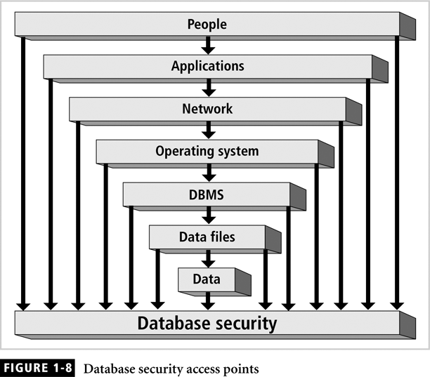
Database Security (2)

Slide 34
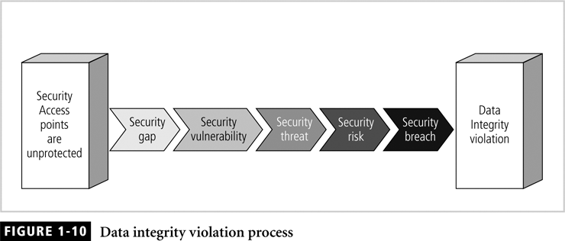
Database Security (3)

Slide 35
Database Security Levels (1)
Relational database: collection of related data files
Data file: collection of related tables
Table: collection of related rows (records)
Row: collection of related columns (fields)

Slide 36
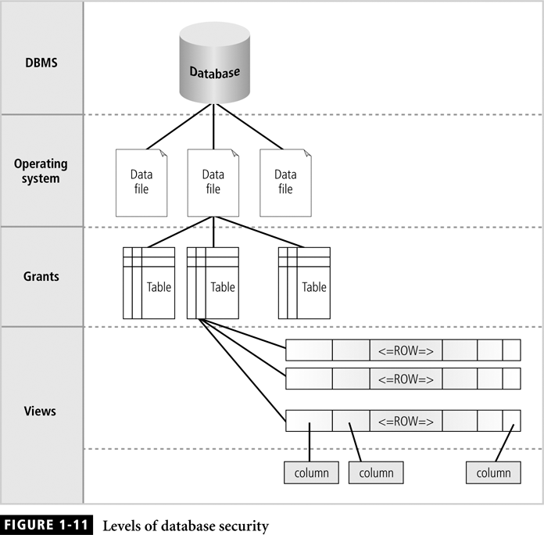
Database Security Levels (2)

Slide 37
Menaces to Databases (1)
Risk = Vulnerability x Threat
Security risk: a known security gap intentionally left open
Security vulnerability: a weakness in any information system component (e.g., poor coding)
Security threat: a security violation or attack that can happen any time because of a security vulnerability (e.g., malware, insider, terrorism)

Slide 38
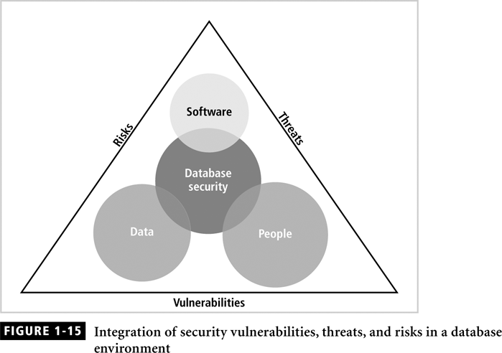
Menaces to Databases (2)

Slide 39
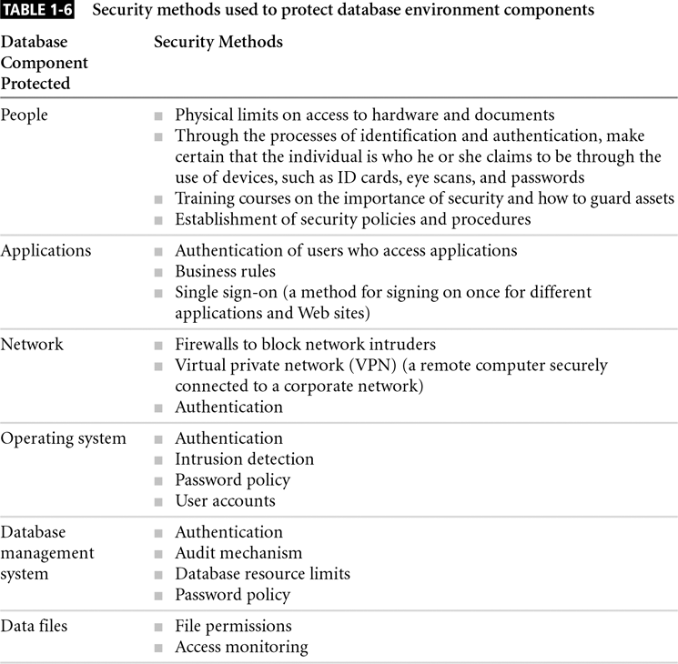
Security Methods (1)

Slide 40
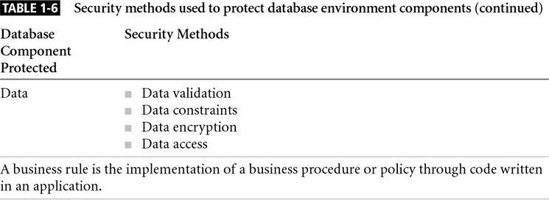
Security Methods (2)

Slide 41
Summary
Security: level and degree of being free from danger and threats
Database security: degree to which data is fully protected from unauthorized tampering
Information systems: backbone of day-to-day company operations
DBMS: programs to manage a database
C.I.A triangle:
Confidentiality
Integrity
Availability
Secure access points
Security vulnerabilities, threats and risks
Information security architecture
Model for protecting logical and physical assets
Company’s implementation of a C.I.A. triangle
Enforce security at all levels of the database

Slide 42
Case Project
You are a DBA working for a bank. One day, a lead developer send you an email requesting that you perform a data change. In the email, he stresses the urgency and importance of this task. A minute later, you received another email but this is from the lead developer's manager to confirm the data change. This is the first time you have ever received this type of request.
List security issues involved in this incident.
Describe the type of risks involved if you comply with the request and the types of risk involved if you do not.
Explain briefly how you would react to this incident, outlining your reasoning and whether you would comply or not.

Slide 43
Assignment #1
MS SQL Server 2005 Installation

Slide 44
Stop Tegrity!

